Slide 1
The Desert Tortoise
Creatures of the Sonoran/Mohave Deserts

Slide 2
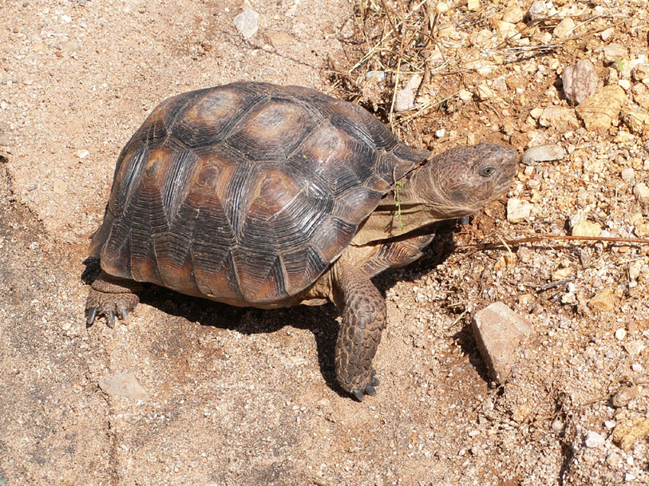
The Desert Tortoise
This tortoise was one of two I found foraging during a hike on the Tanque Verde Ridge trail, on the Rincorn Mountains, Tucson, Arizona.
Normally they are extremely difficult to find during the day! They spend up to 95% of their life underground.

Slide 3
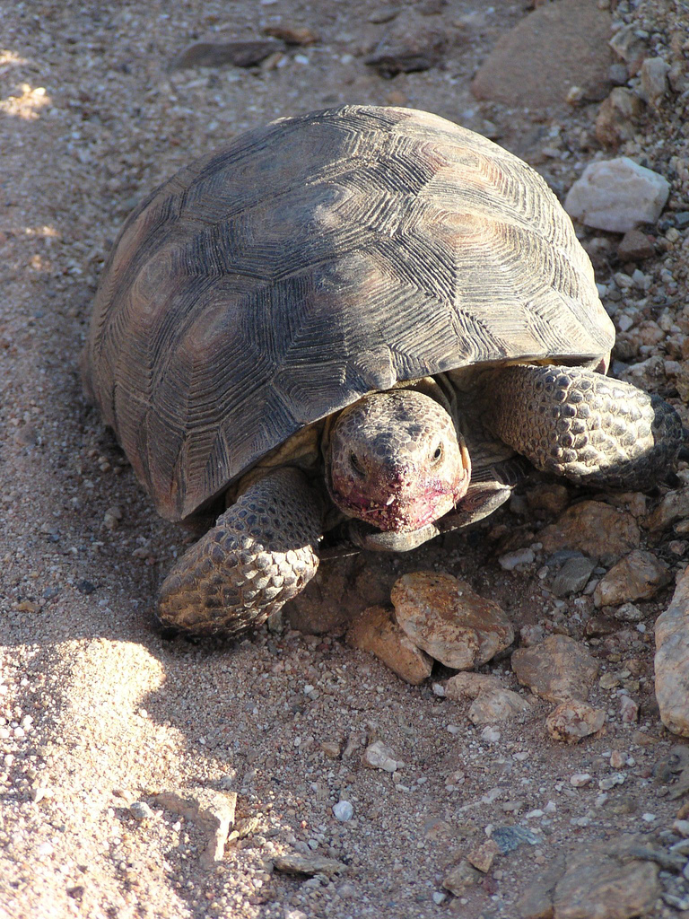
The Desert Tortoise
They hibernate from November to March in a burrow or at the base of a brush. During this hibernation the body metabolism slows and its temperature drops.

Slide 4
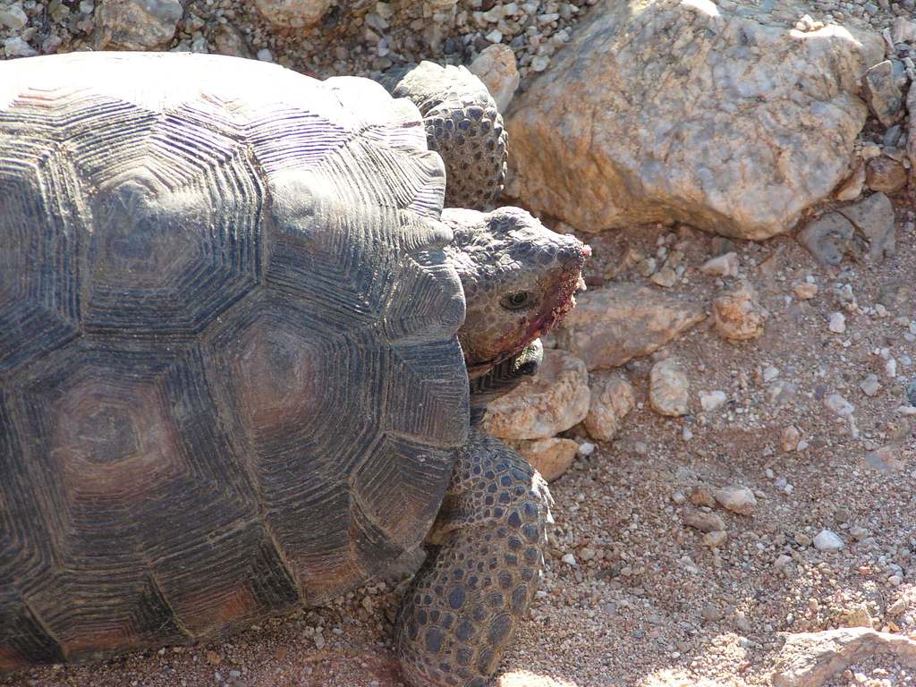
The Desert Tortoise
The female lays her eggs, up to fourteen, between Mid-April to early June.
The odds for survival are small, since the small hatchlings have many predators, including foxes, badgers, coyotes, ravens and roadrunners.
This tortoise has just been eating a prickly pear from a cactus.

Slide 5

The Desert Tortoise
The Heat is On:
Desert Tortoises and Survival
(Full video)

Slide 6
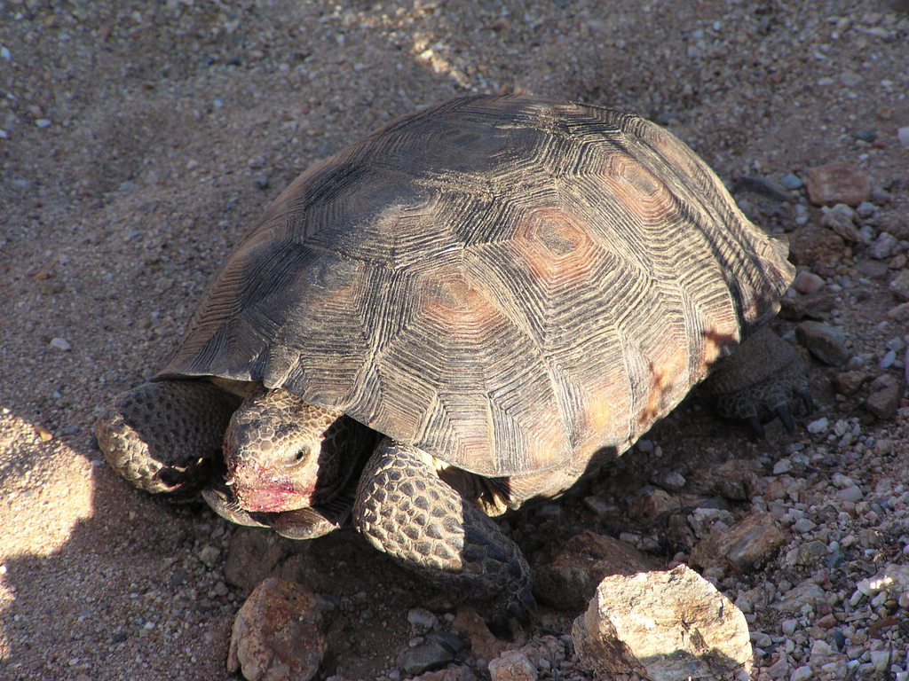
The Desert Tortoise
The desert tortoise manages to survive harsh desert conditions by adapting to its environment.
They can live up to 50 years.
They eat leaves, cacti and grasses on rocky well-vegetated slopes and washes.

Slide 7
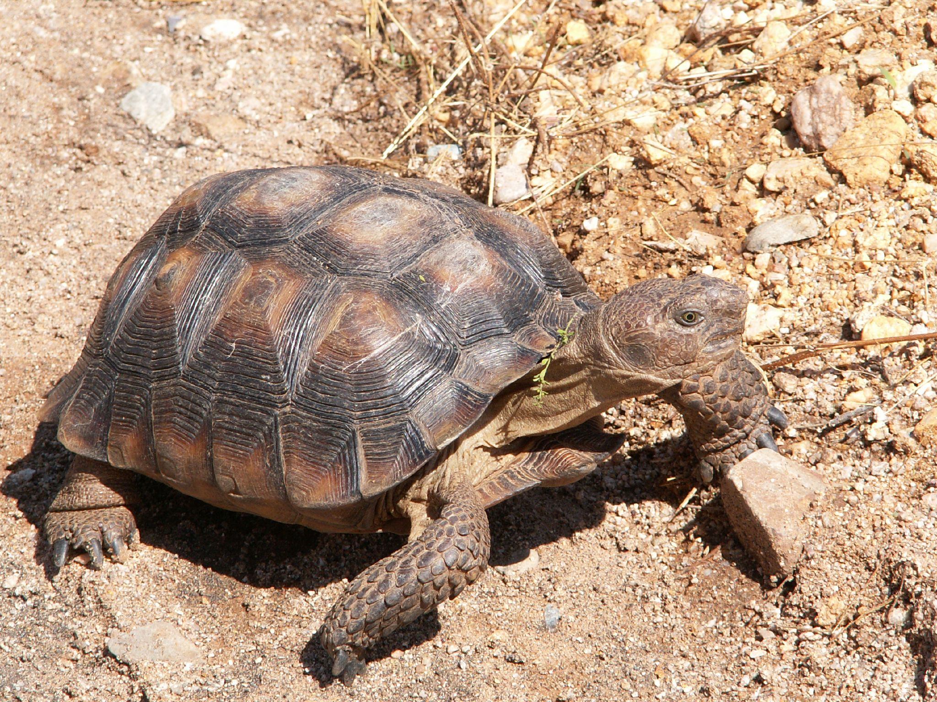
The Desert Tortoise
The desert tortoise is a herbivore. It eats mainly grasses, but it also eats herbs, annual wildflowers, and new growth of cacti and their fruit and flowers.

Slide 8
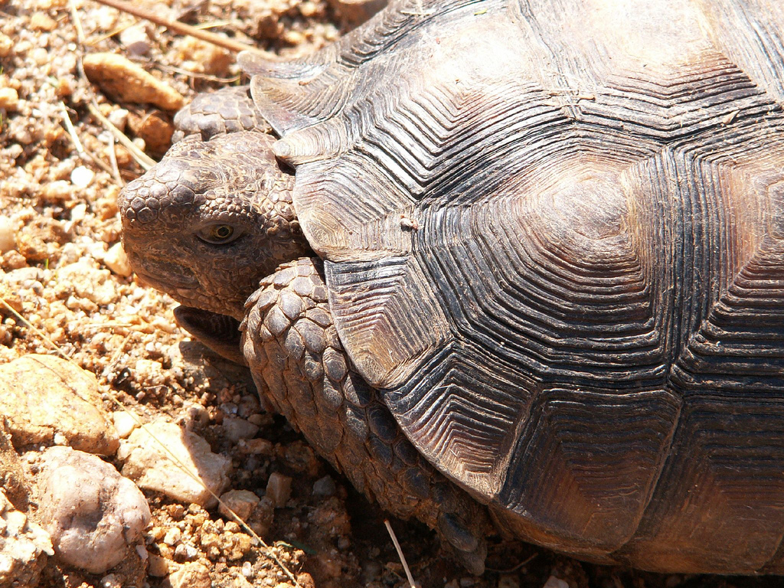
The Desert Tortoise
They obtain all the water they need from their food, but they will drink if water is available.
In the Sonoran Desert, the summer 'monsoon' season provides a welcome drench from the hot dry conditions where the temperatures regularly exceed 40 °C .

Slide 9
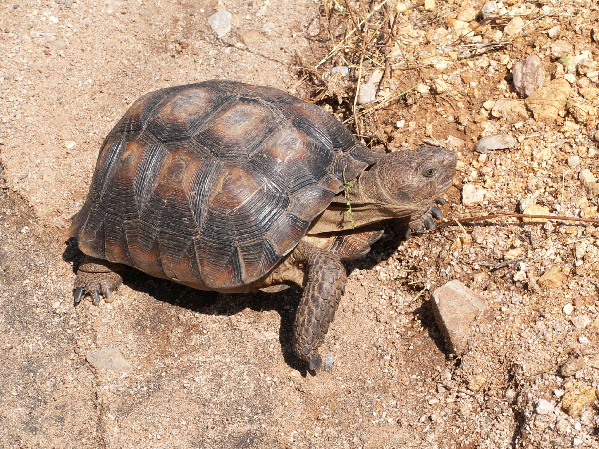
The Desert Tortoise
Desert tortoises grow slowly and they and have low reproductive rates.
Desert tortoises spend much of their time in burrows or rock shelters, in order to regulate body temperature and reduce water loss.
They are most active after seasonal rains.

Slide 10
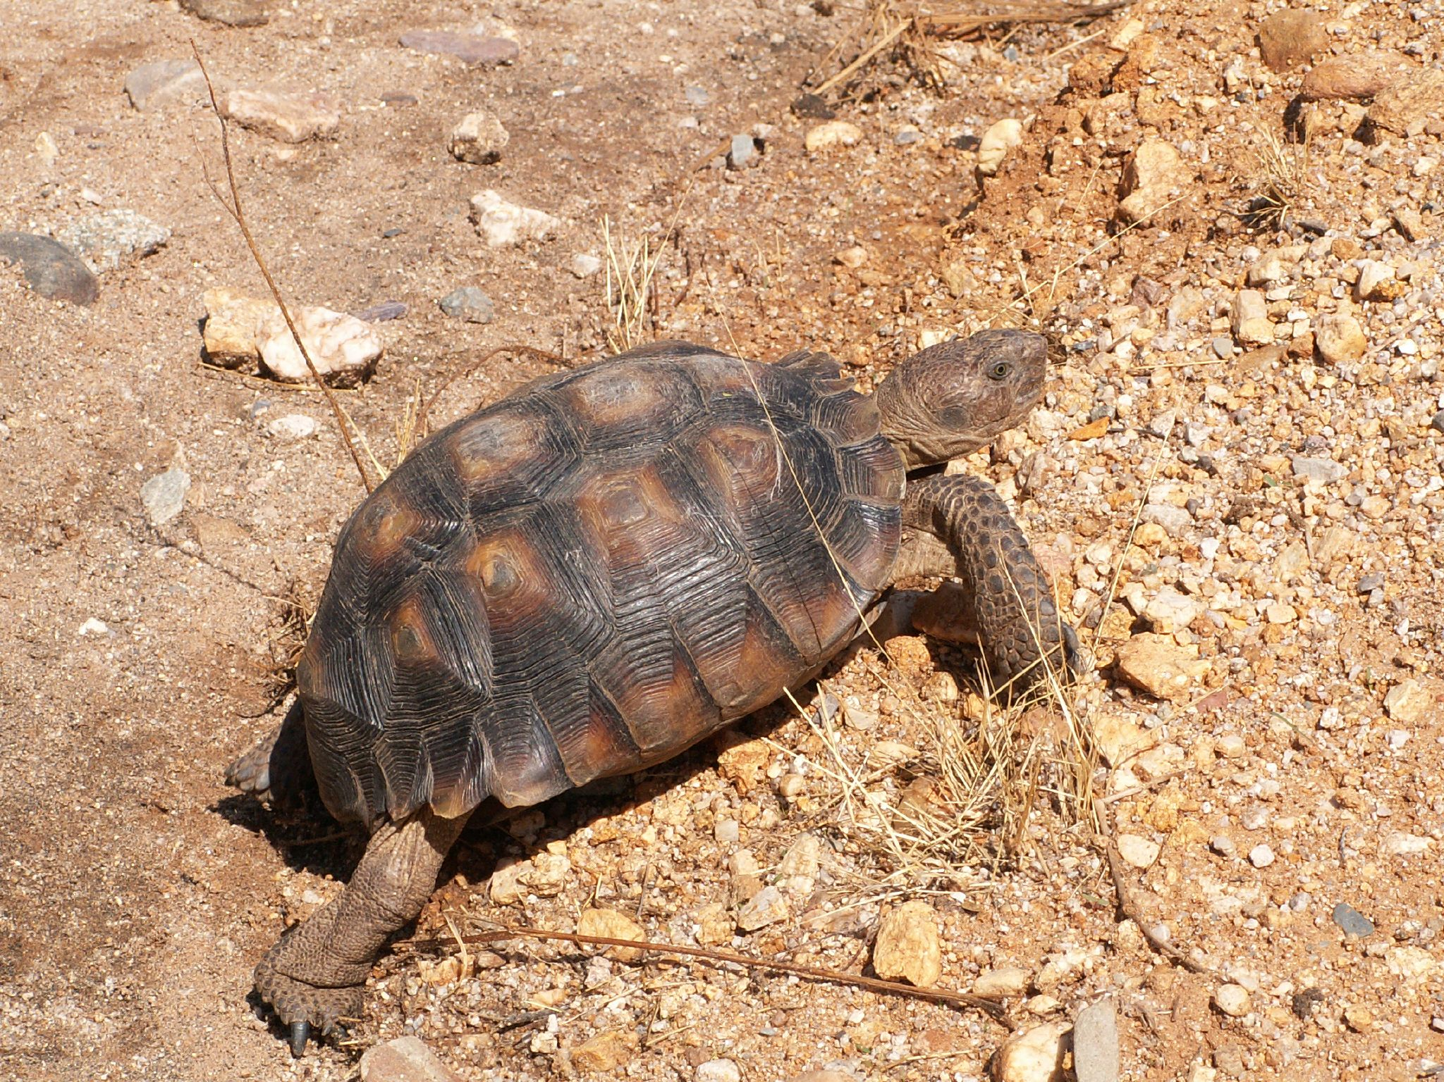
The Desert Tortoise
Desert tortoise populations in some areas have been reduced by as much as 90% since the 1980s.
Threats to tortoises include urbanization, disease, and habitat destruction. Other threats include illegal collection by humans, and habitat changes as a result of invasive plant species
It is unlawful to touch, harm, harass, or collect wild desert tortoises.

Slide 11
The Desert Tortoise
The Desert Tortoise’s Life…
(Video)

